Slide 1


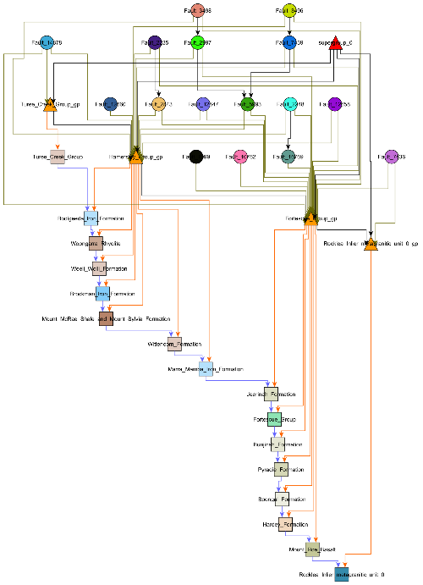
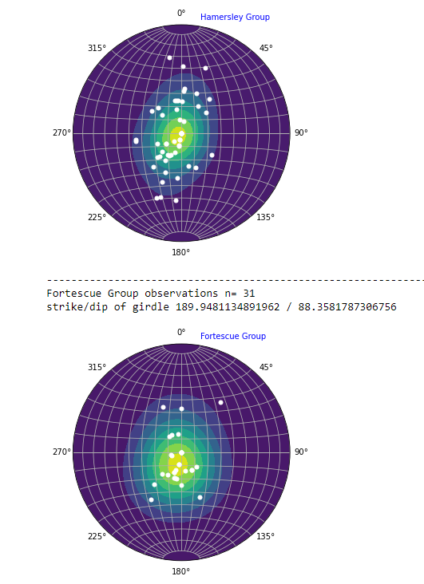
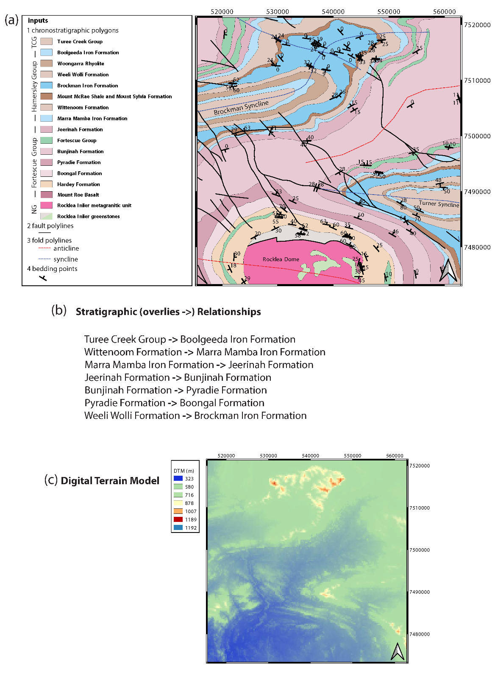






WP2: Map deconstruction aids 3D model construction
Mark Jessell, Vitaliy Ogarko, Mark Lindsay, Ranee Joshi, Lachlan Grose, Laurent Ailleres, Michel Nzikou, Guillaume Pirot
Busselton March 2020

Slide 2
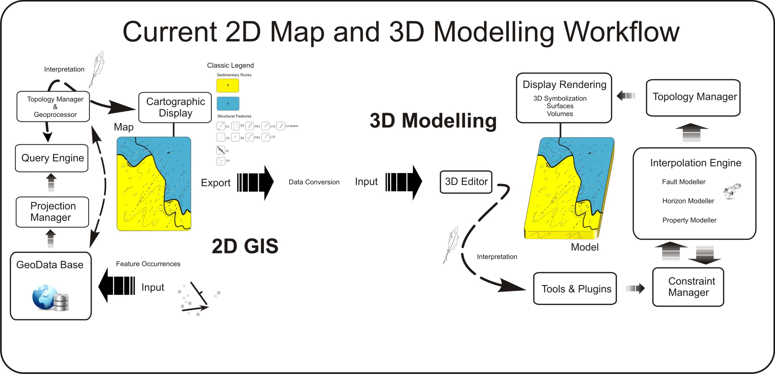
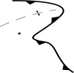
One-way one-model !
WP2
EDK
WP2 will provide Loop with the ability to directly access online and offline geoscientific datasets, which it will then process to extract the data required for 3D Geological Modelling. This includes re-projection, upscaling, information extraction and exporting in native formats aimed at a variety of implicit 3D Geological modelling engines.
Notes:
How do we currently make our 3D models, a quick generalization is worth reflecting on. In the end we follow a linear workflow. Models are rarely used to update a primary data store with new relationship or insight. All new knowledge is embedded in the model.

Slide 3
Why map2loop?
Significantly reduces the time to first prototype models;
Allows reproducible modelling from raw data, whereas current Uncertainty Quantification workflows start from model-ready inputs;
Clearly separates the primary observations, interpretations, derived data and conceptual priors during the data reduction steps; and
Provides a homogenous pathway to Sensitivity Analysis, Uncertainty Quantification, Multiscale Modelling and Value of Information studies

Slide 4
Principles:
Accept structured data as-is
allows real-time modelling
Modify on the fly
reproject, upscale, derive missing information, define conceptual constraints
Iteratively define all parameters needed to build a model so that they can be front-loaded into map2loop
ensures reproducibility

Slide 5
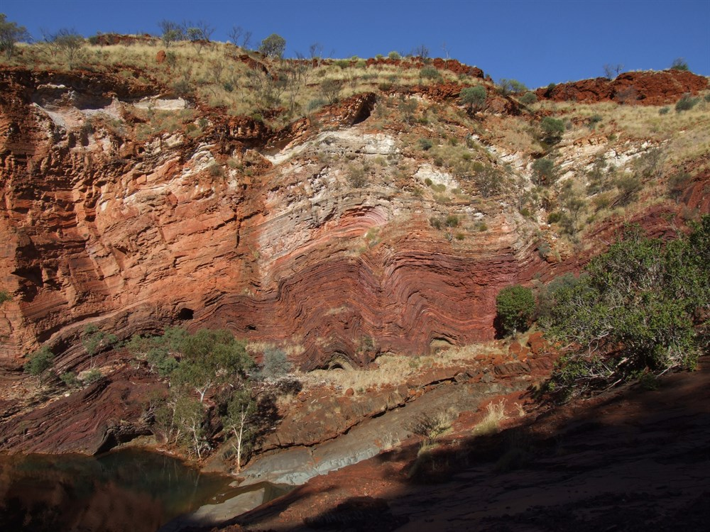
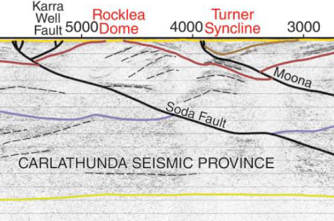
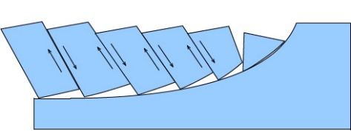
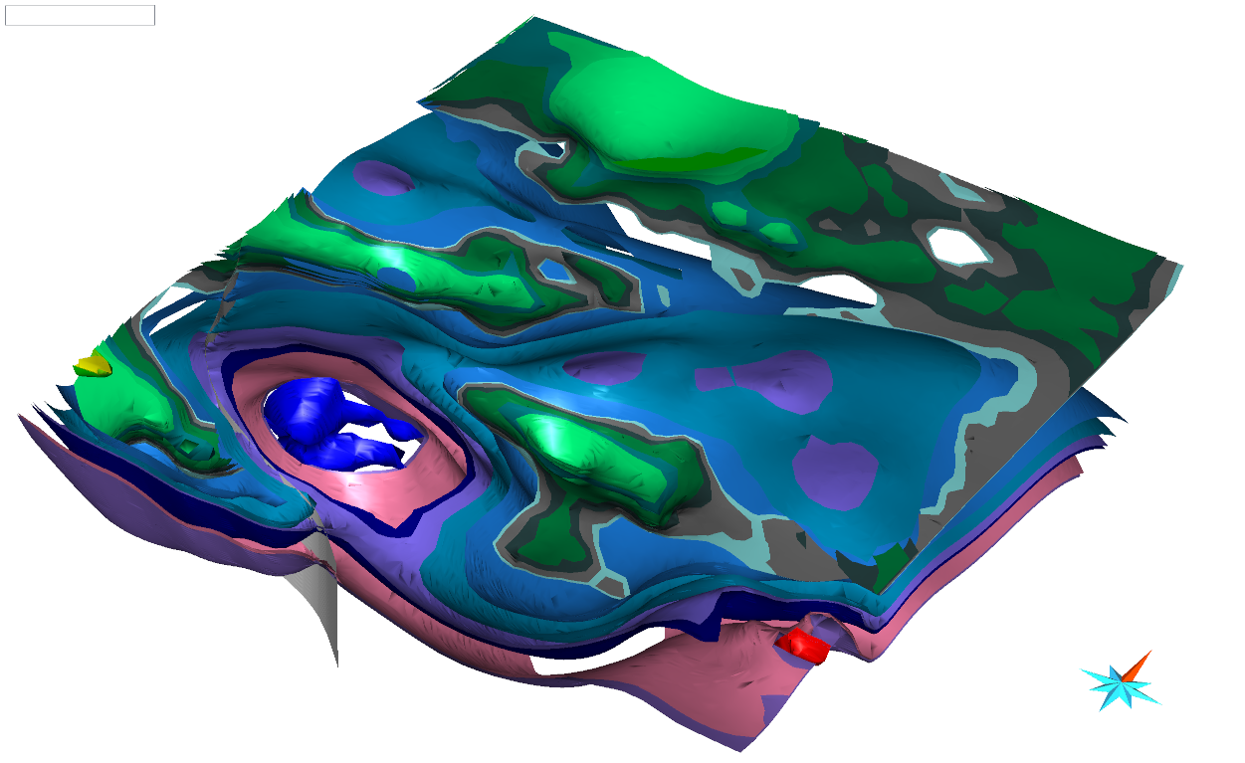
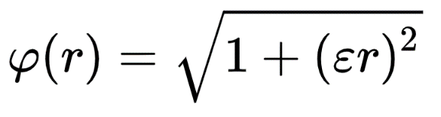
Ingredients of a 3D geological model (and sources of uncertainty)
Observations
Interpretations
Concepts
Algorithms

Slide 6

Current 3D Modelling Workflow
Observations
Concepts
Interpretations
Algorithms

Slide 7
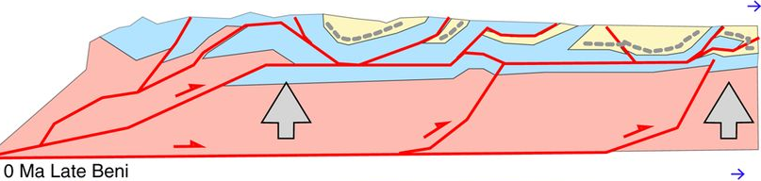
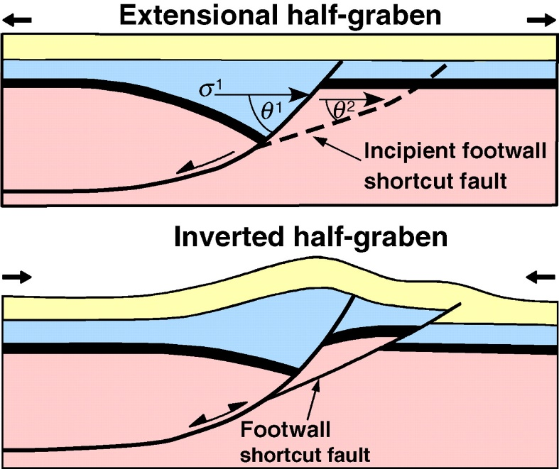

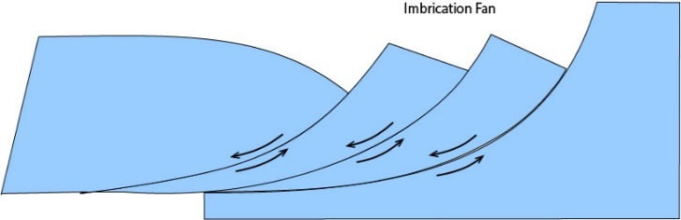
Prior concepts about region (faults)
Without limited geophysical constraints, the sub-surface geometry of faults is often ‘solved’ by applying a pre-conceived notion based on vertical, listric, flower or negative flow, fold & thrust geometries.

Slide 8
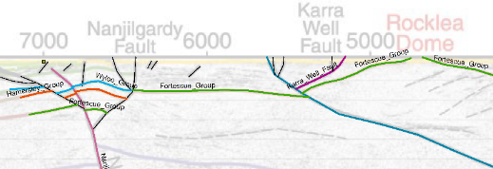
Prior concepts about region (faults)

Slide 9
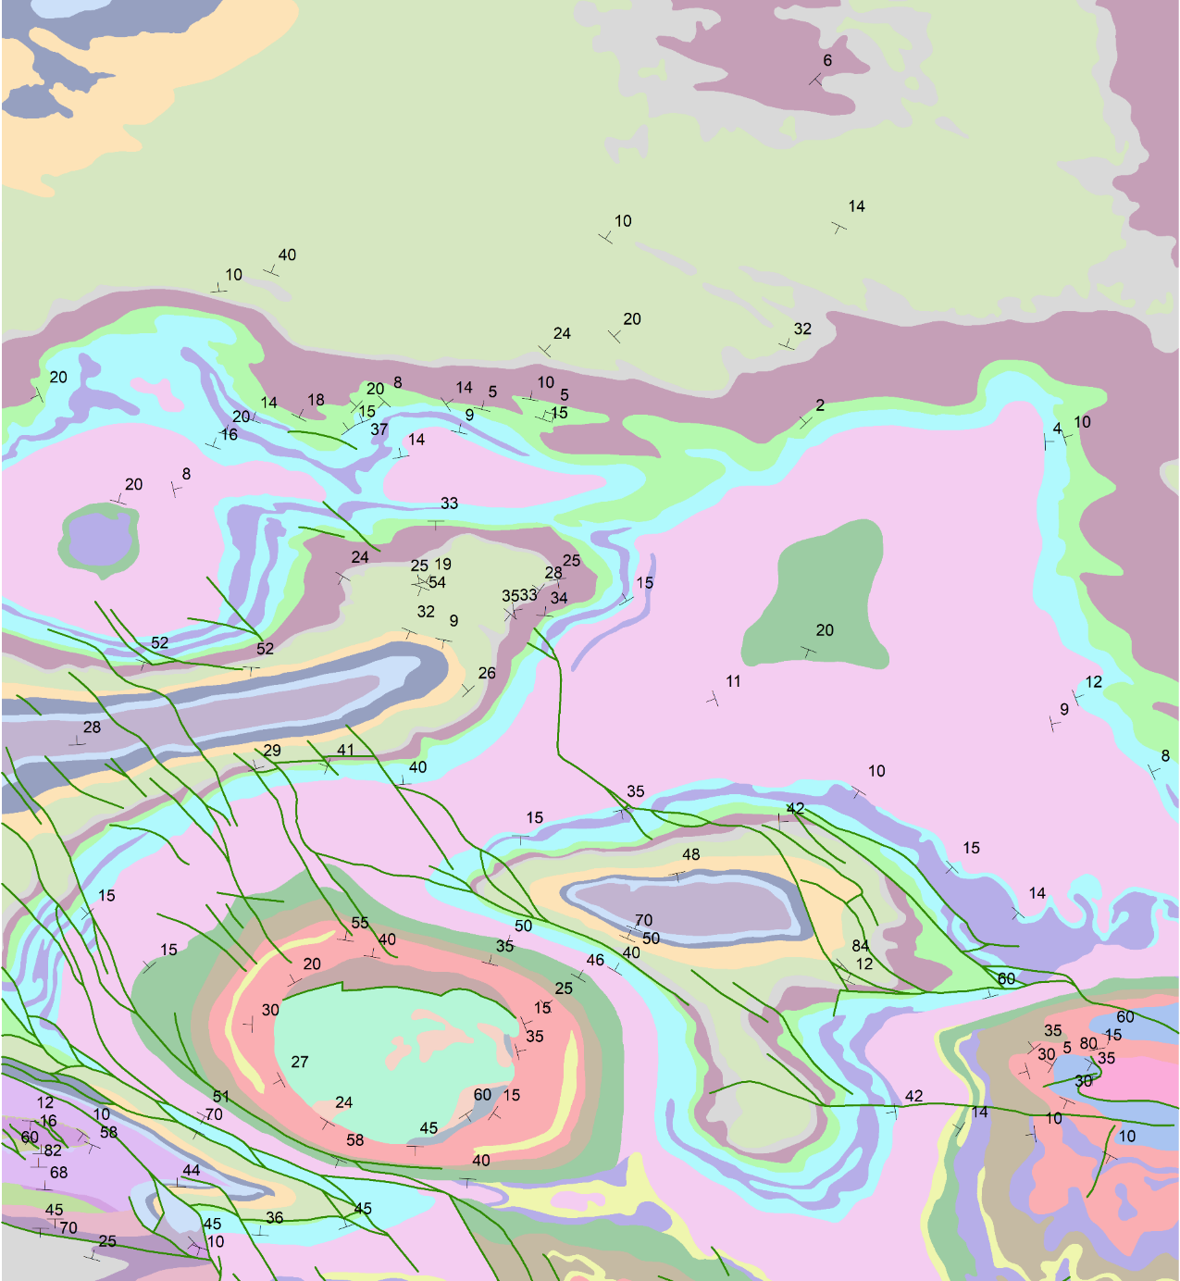
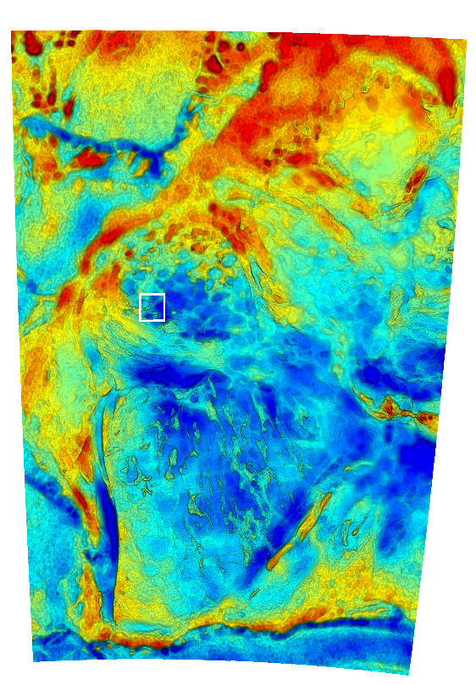
Two end-member regional 3D modelling scenarios:
Geological constraints come FIRST
GSWA 500K
Interpreted Bedrock Geology
1 degree square

Slide 10
Two end-member regional 3D modelling scenarios:
Geological constraints come FIRST
Under cover, so geophysics is FIRST constraint
Qs
GSWA 500K IBG

Slide 11
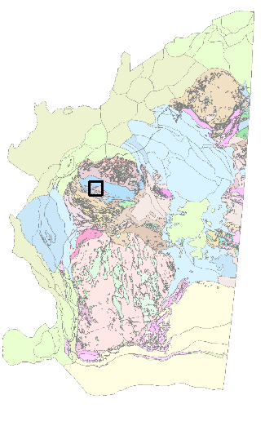
Loop Information Manager
map2loop
3 layers available via WFS
at geo.loop-gis.org/geoserver
Geology polygons (GSWA 500k IGB)
Fault polylines (surface trace, state)
Structural points (bedding, local area)
DTM online from GA

Slide 12
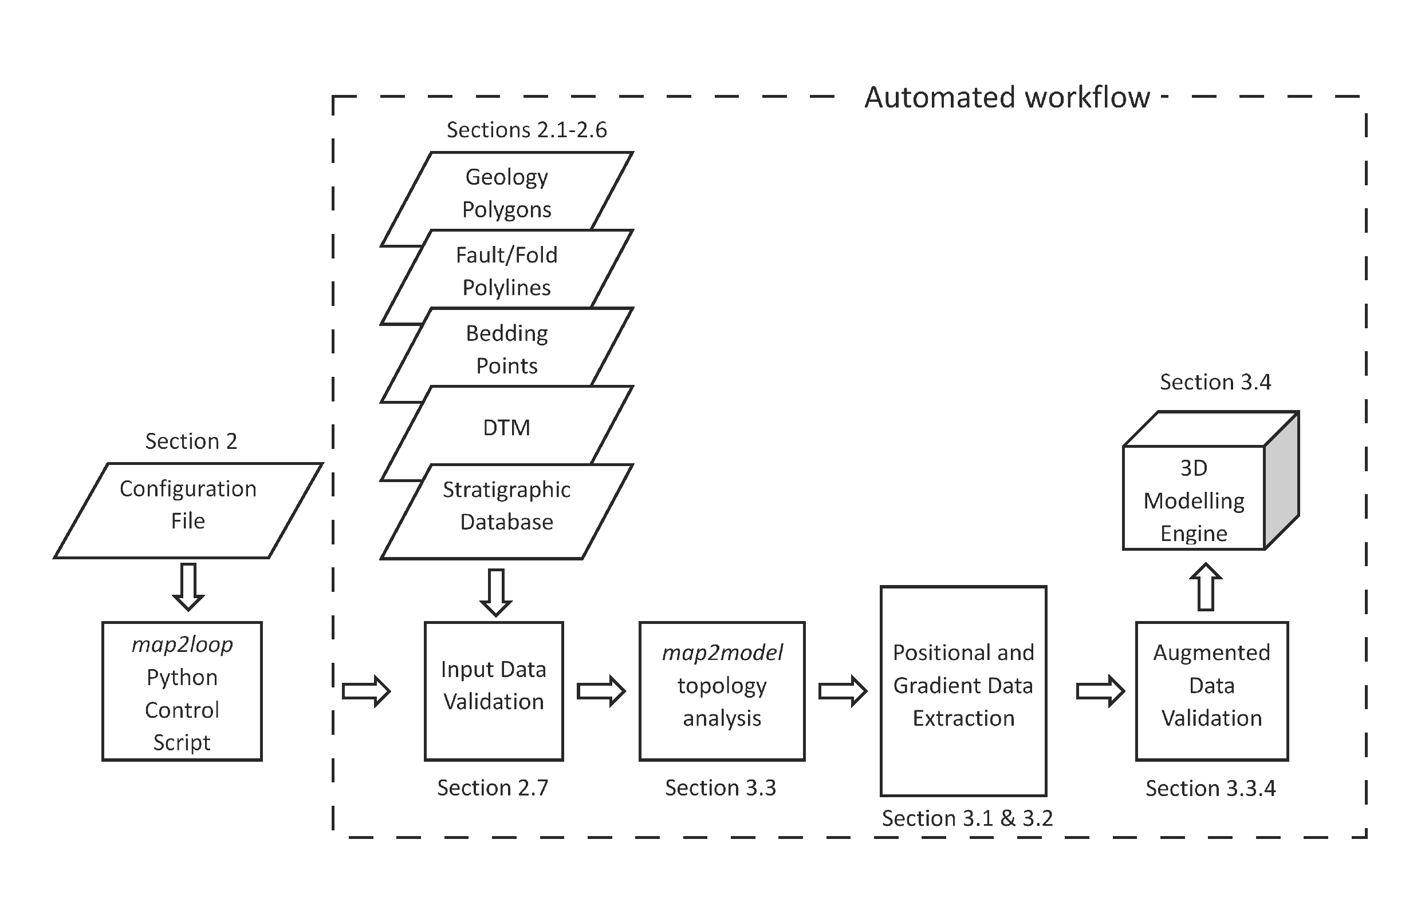

Slide 13
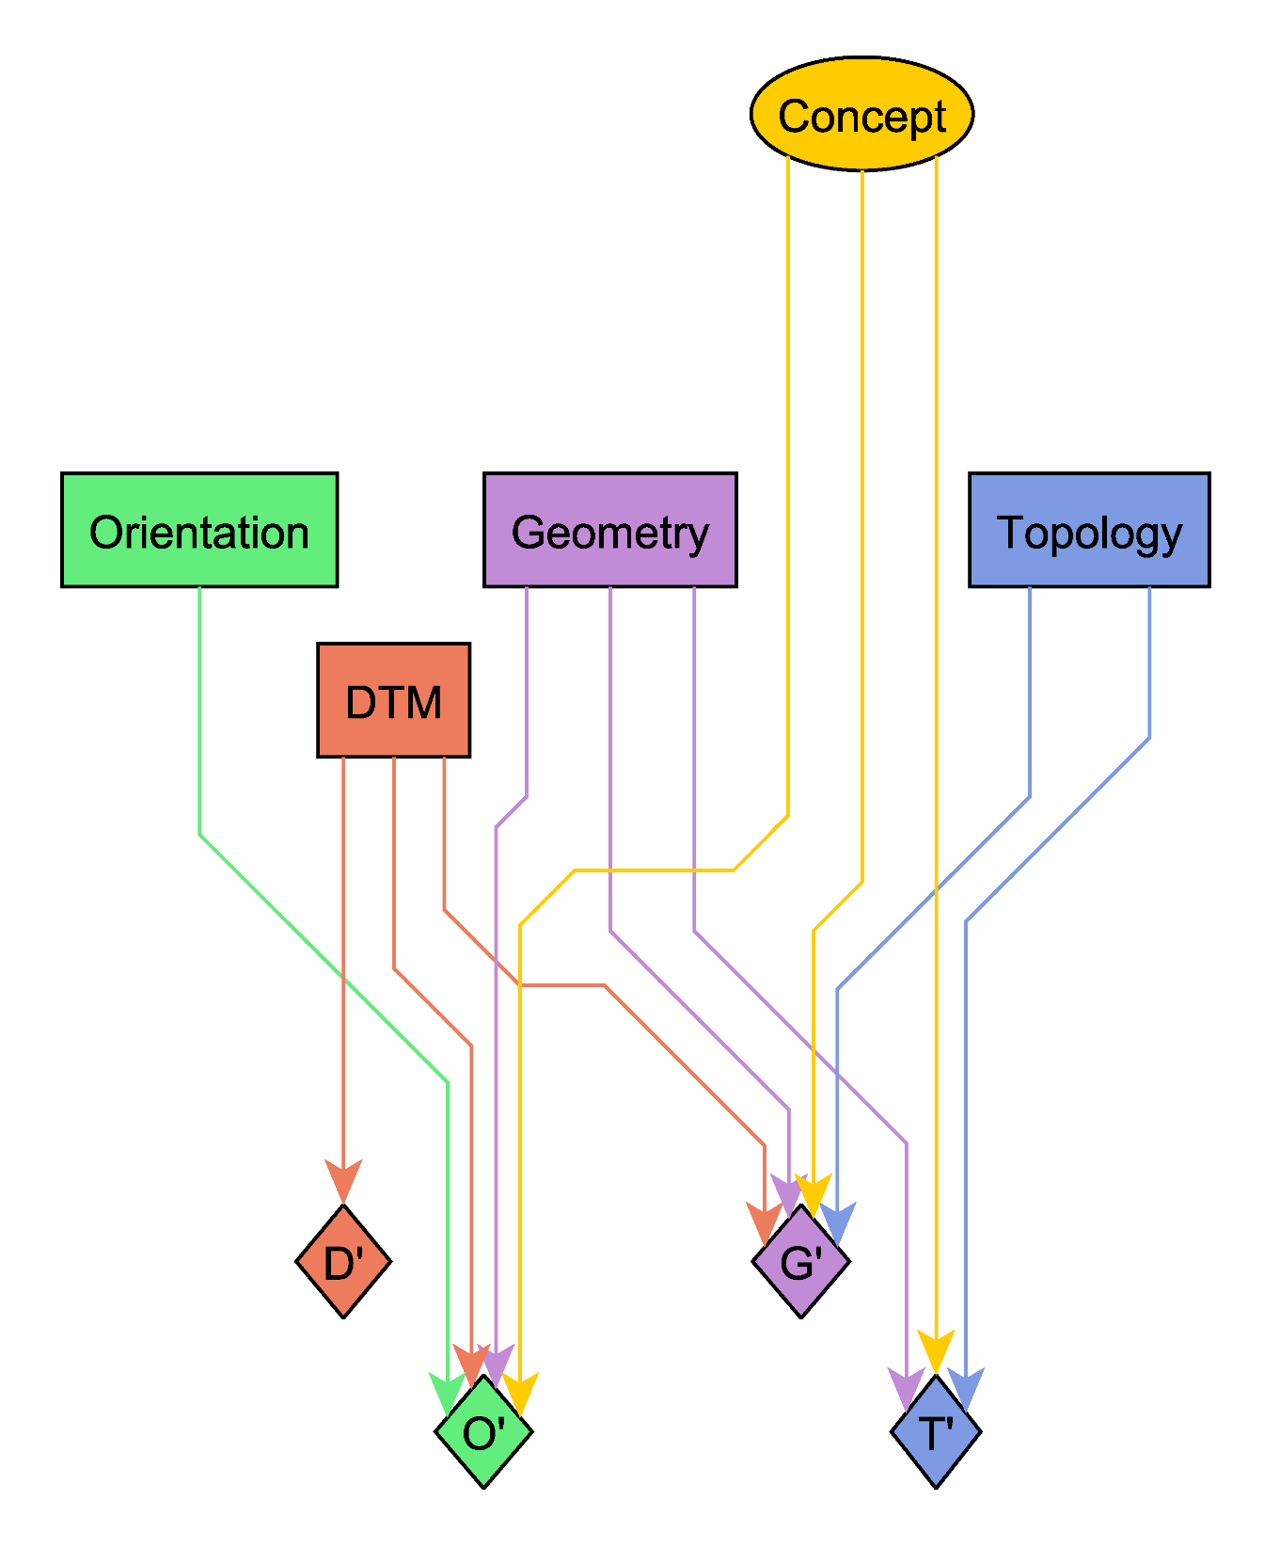
Concepts:
What is the geological framework in this region?
Observations:
Gradient
Position
Topology
DTM
Outputs:
Selected Observations
Subsampled Observations
Derived measurements
Gradient
Position
D’
P’
G’
T’

Slide 14
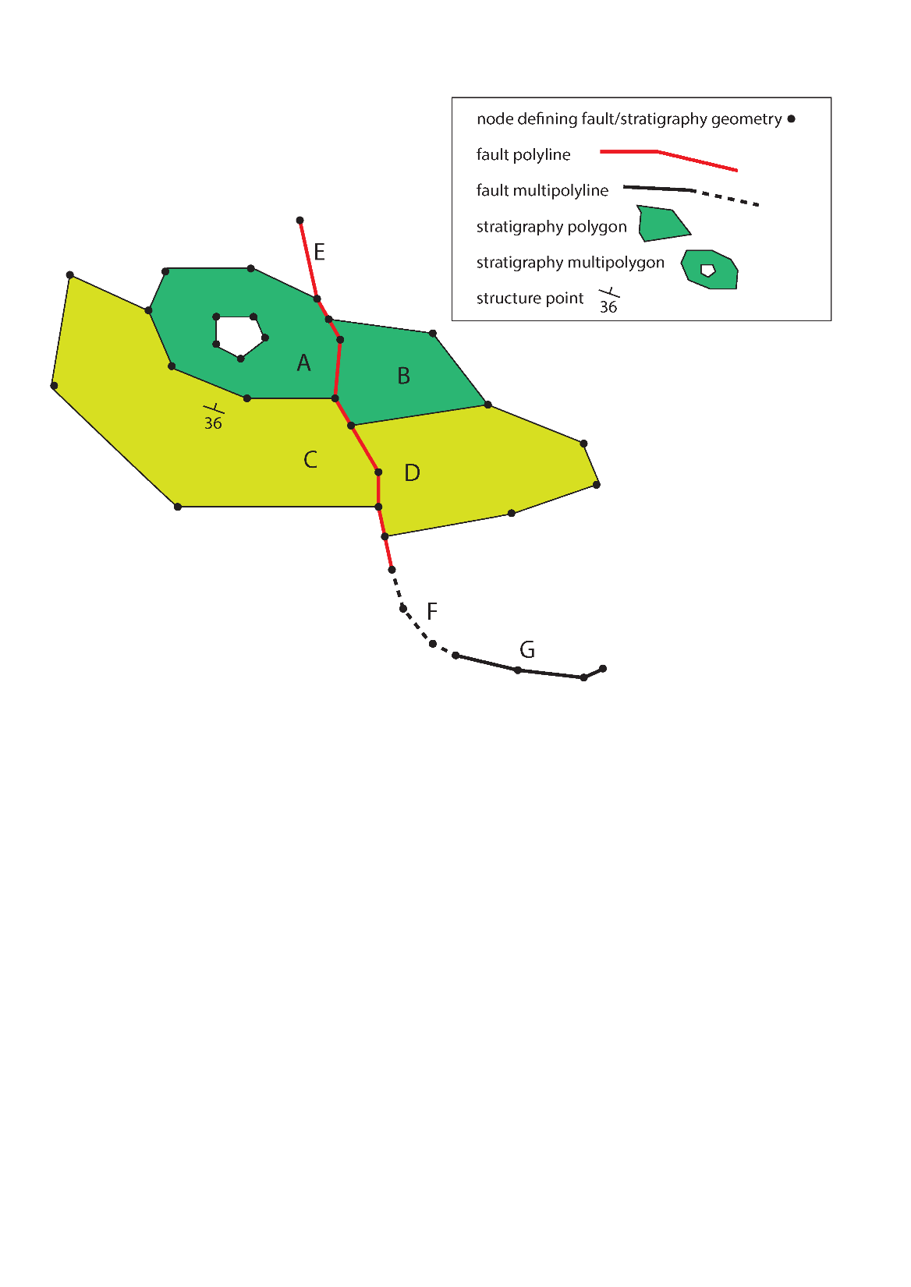
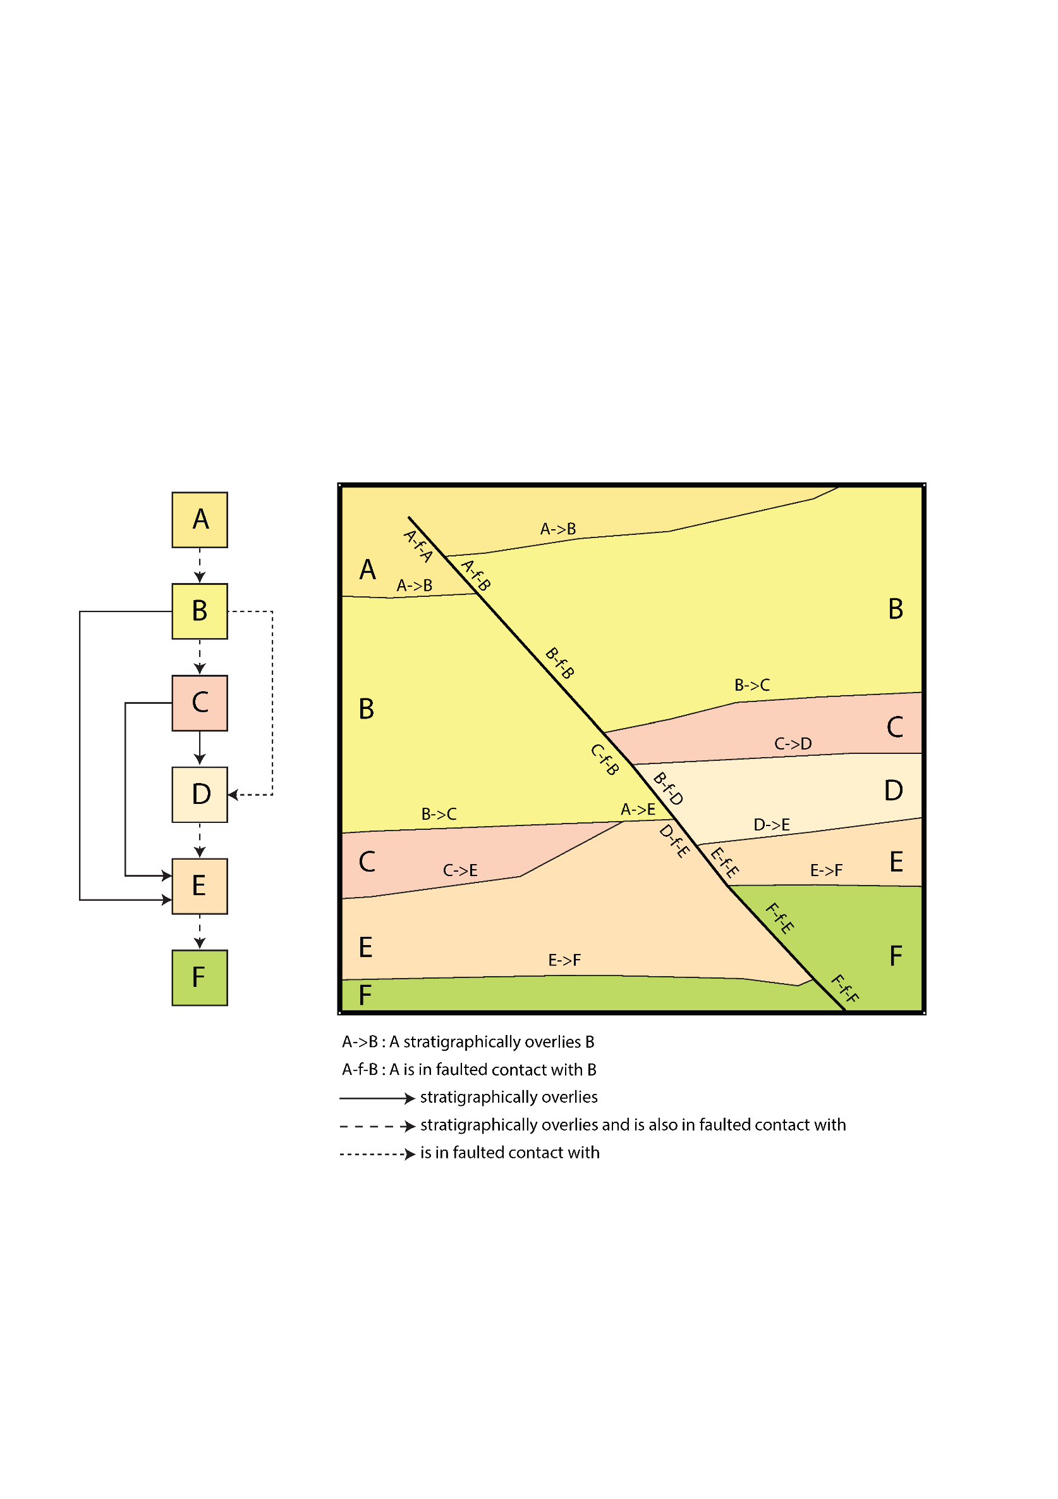
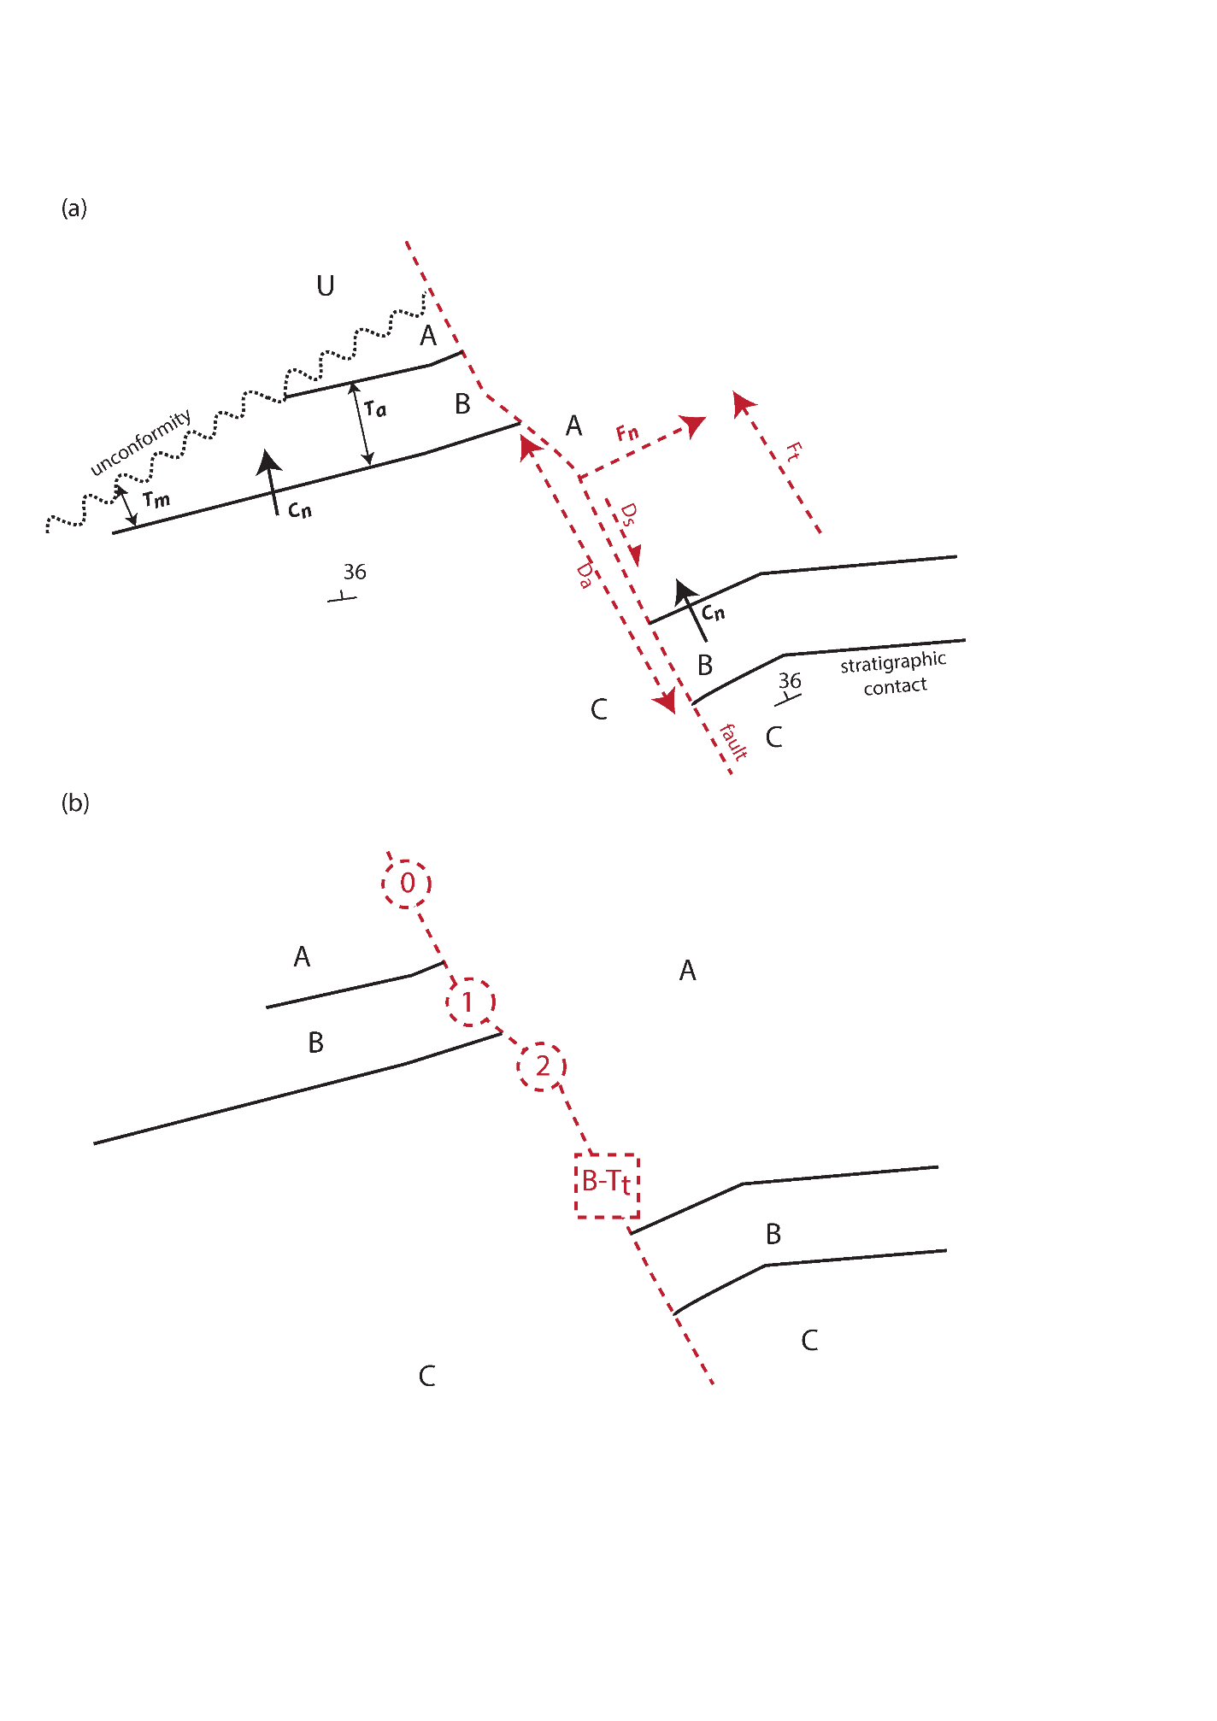
DTM RASTER
Fault displacement & formation thickness estimates

Slide 15
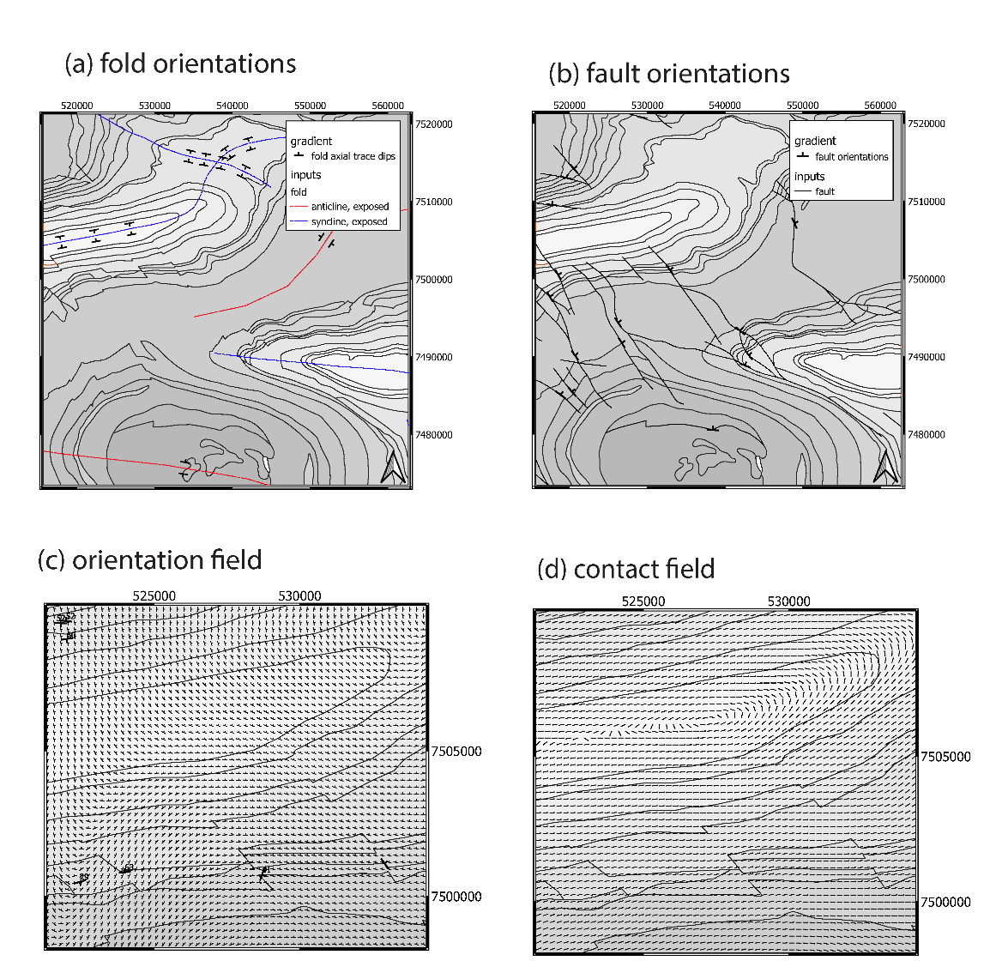
Outputs as series of cvs files & single LoopProjectFile

Slide 16
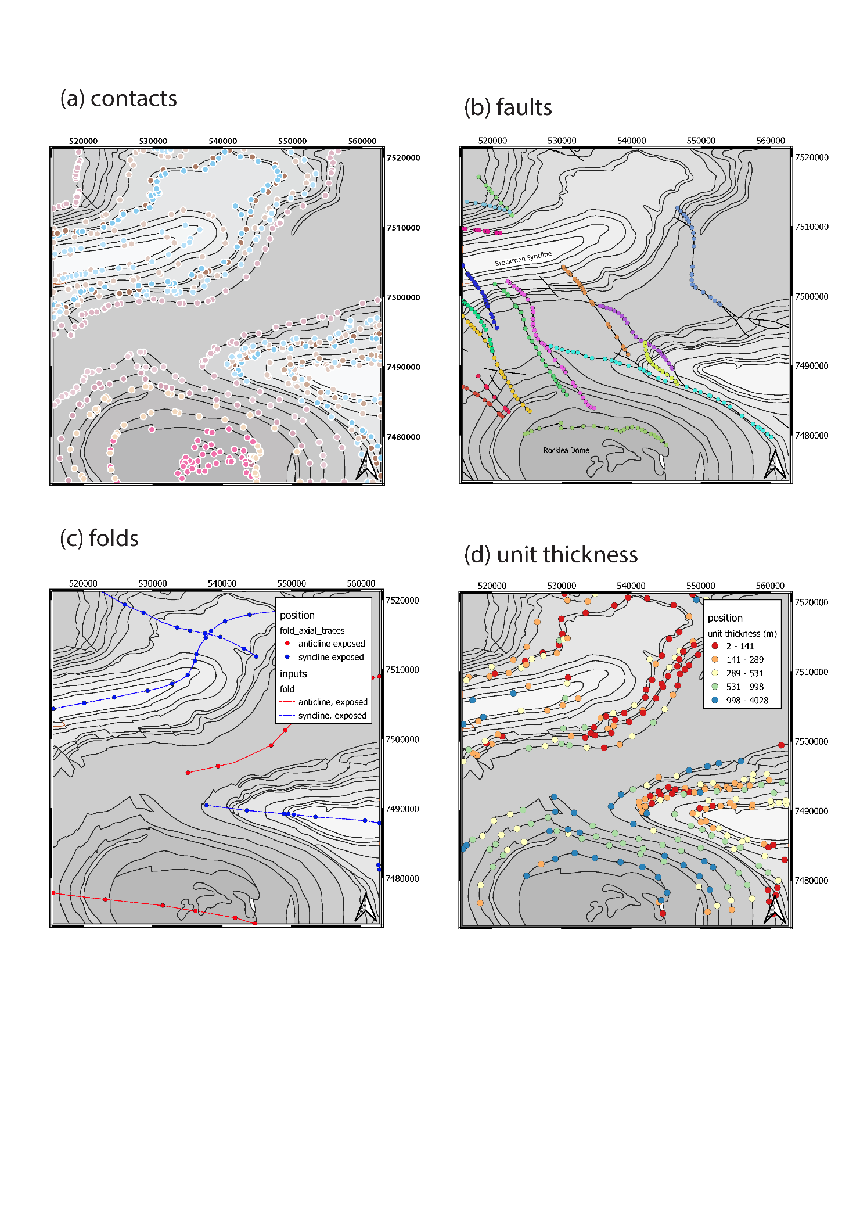
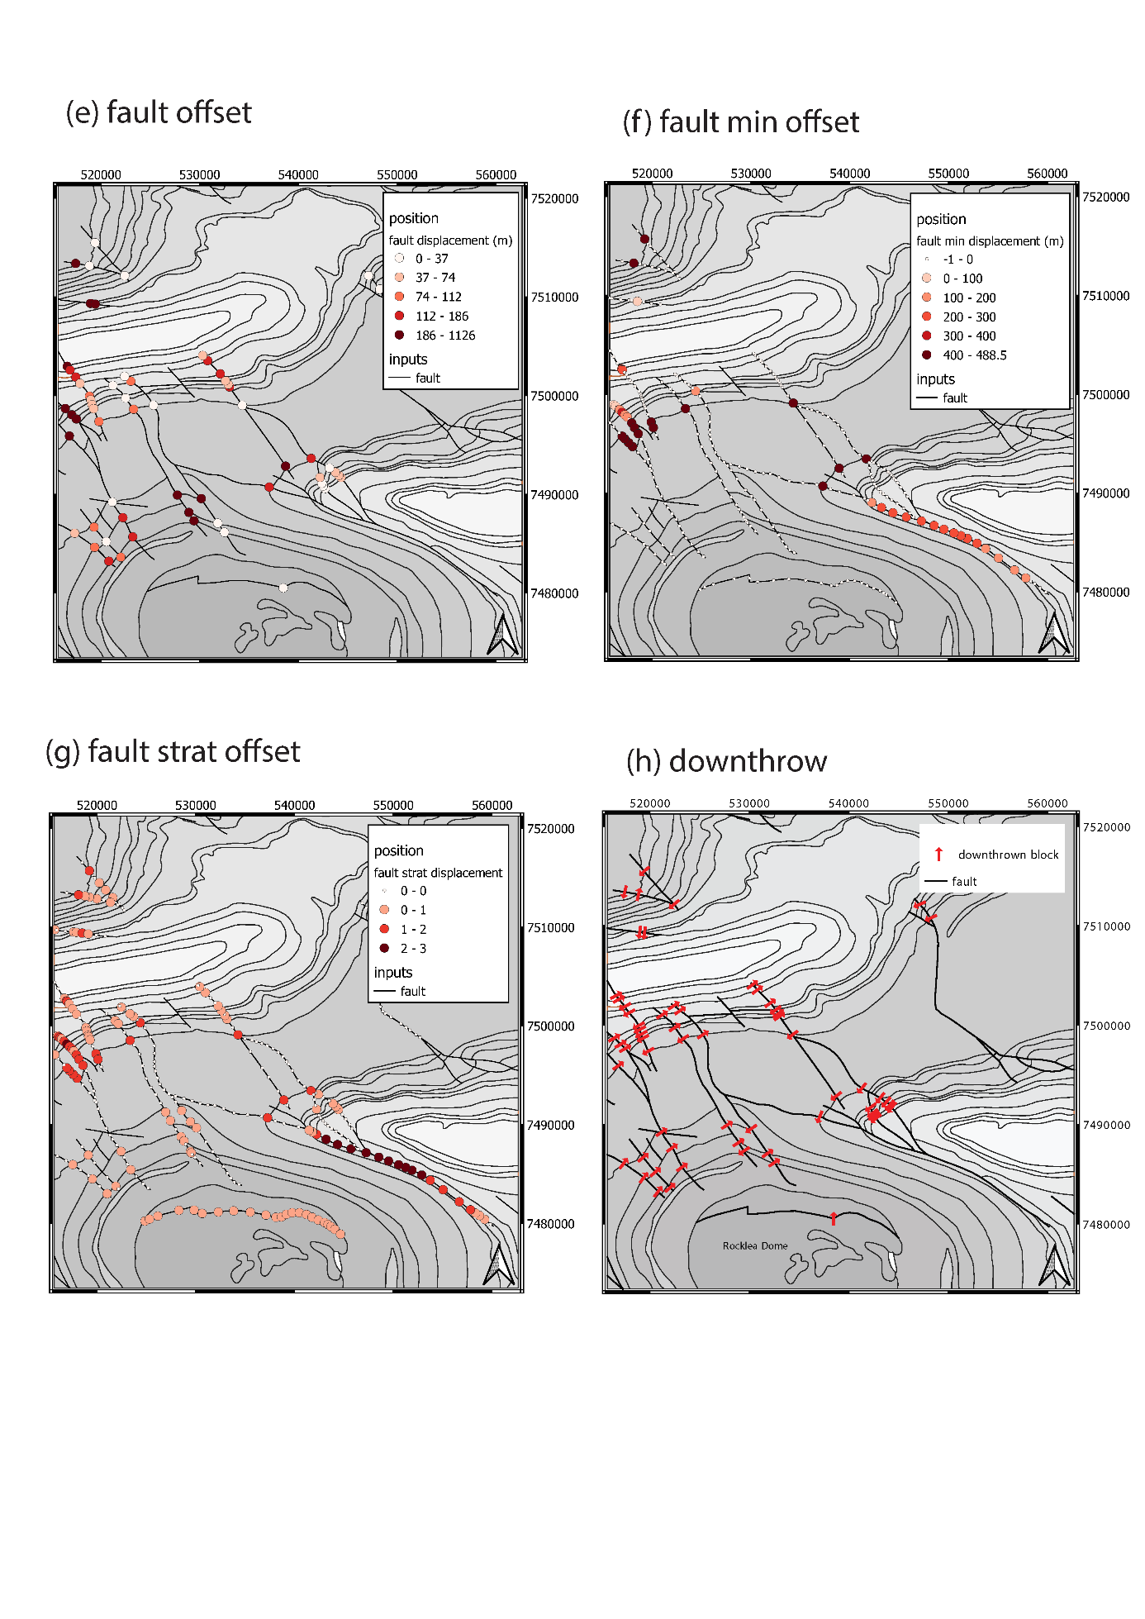

Slide 17
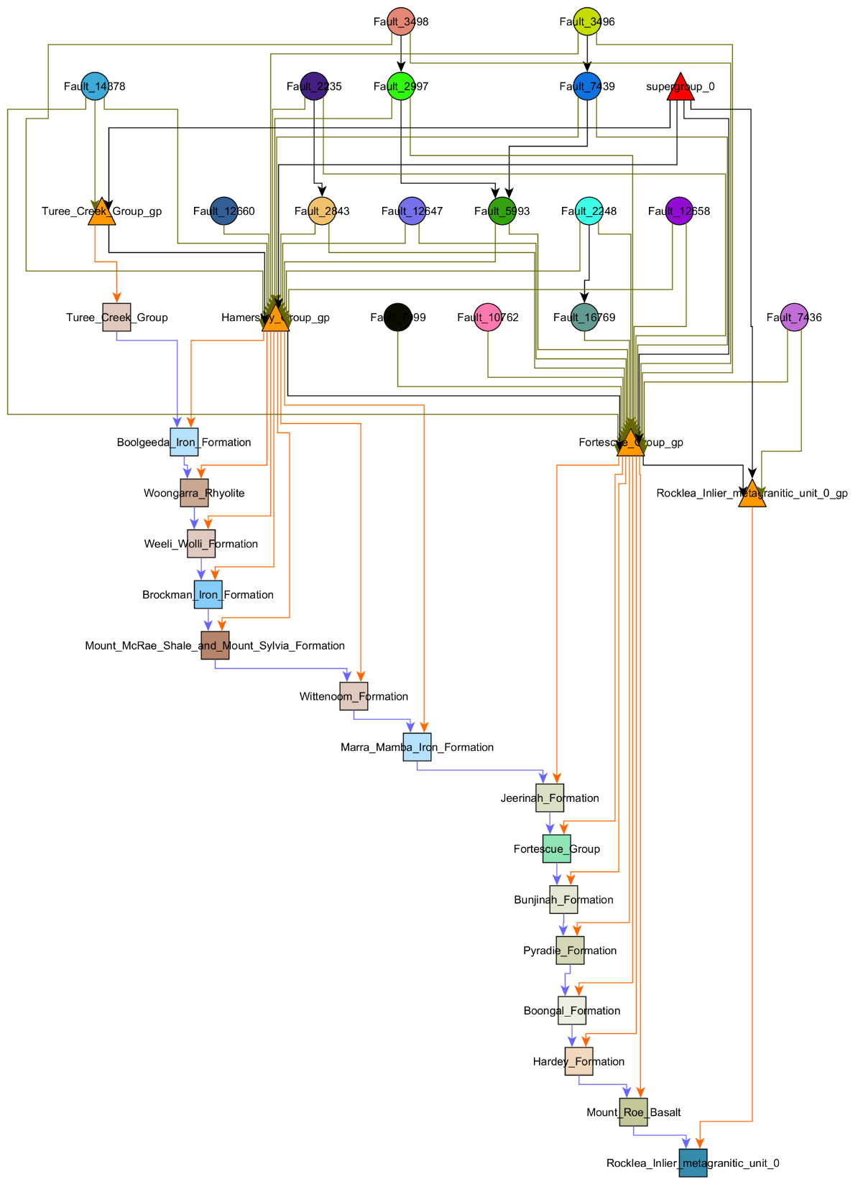
Faults
Young
Groups
Old
Formations

Slide 18
DTM RASTER
Fault displacement & formation thickness estimates

Slide 19
Outputs as series of cvs files & single LoopProjectFile

Slide 21
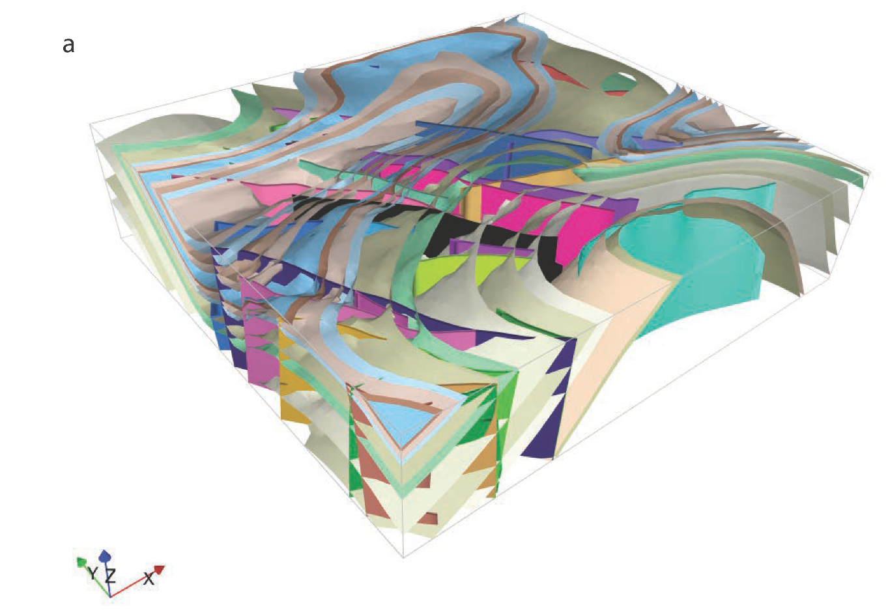

Slide 22
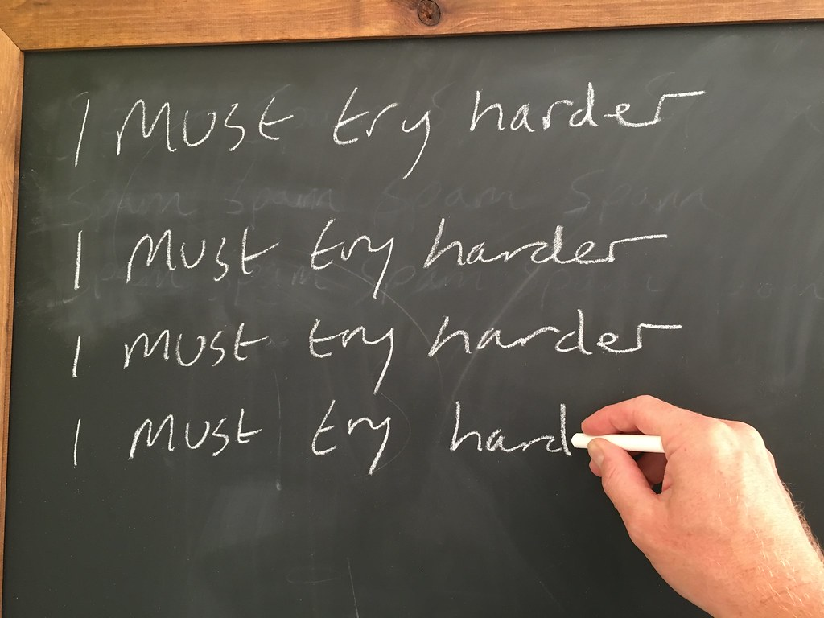
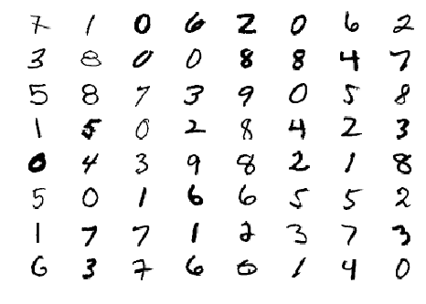
Weaknesses of maploop

Slide 23
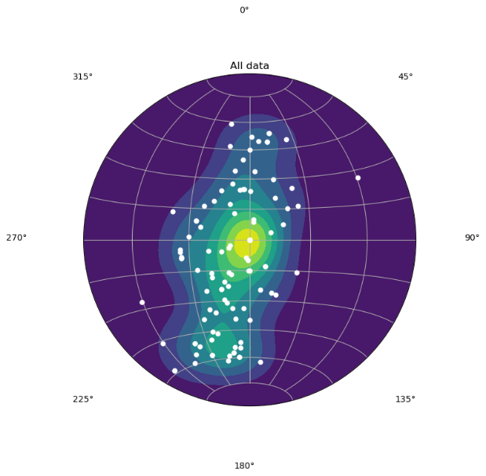
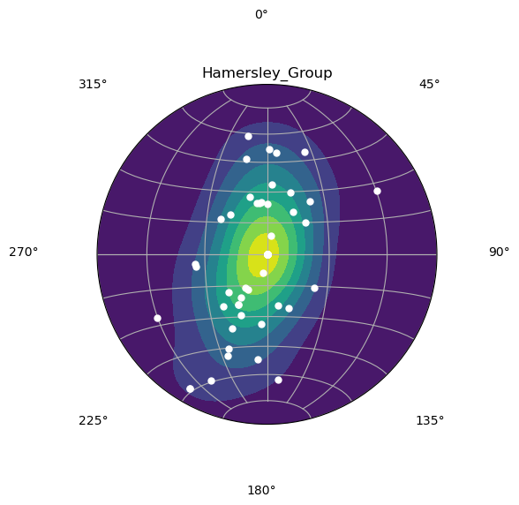
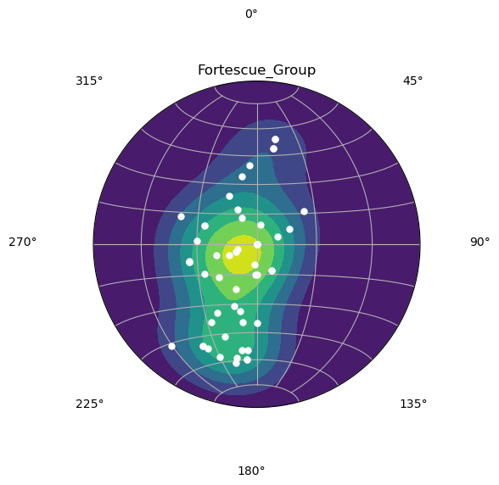
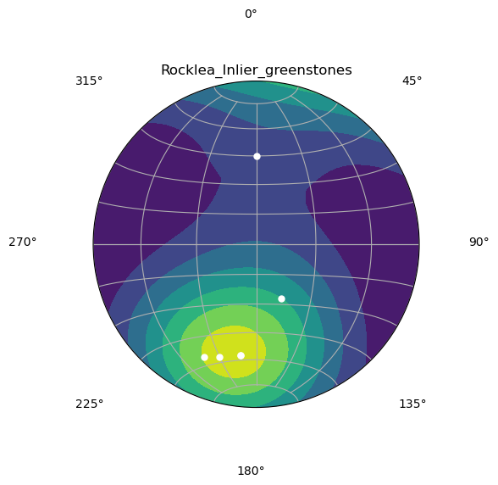
All bedding
Structural domaining, at present
Hamersley Gp
Fortescue Gp
Rocklea Inlier

Slide 24
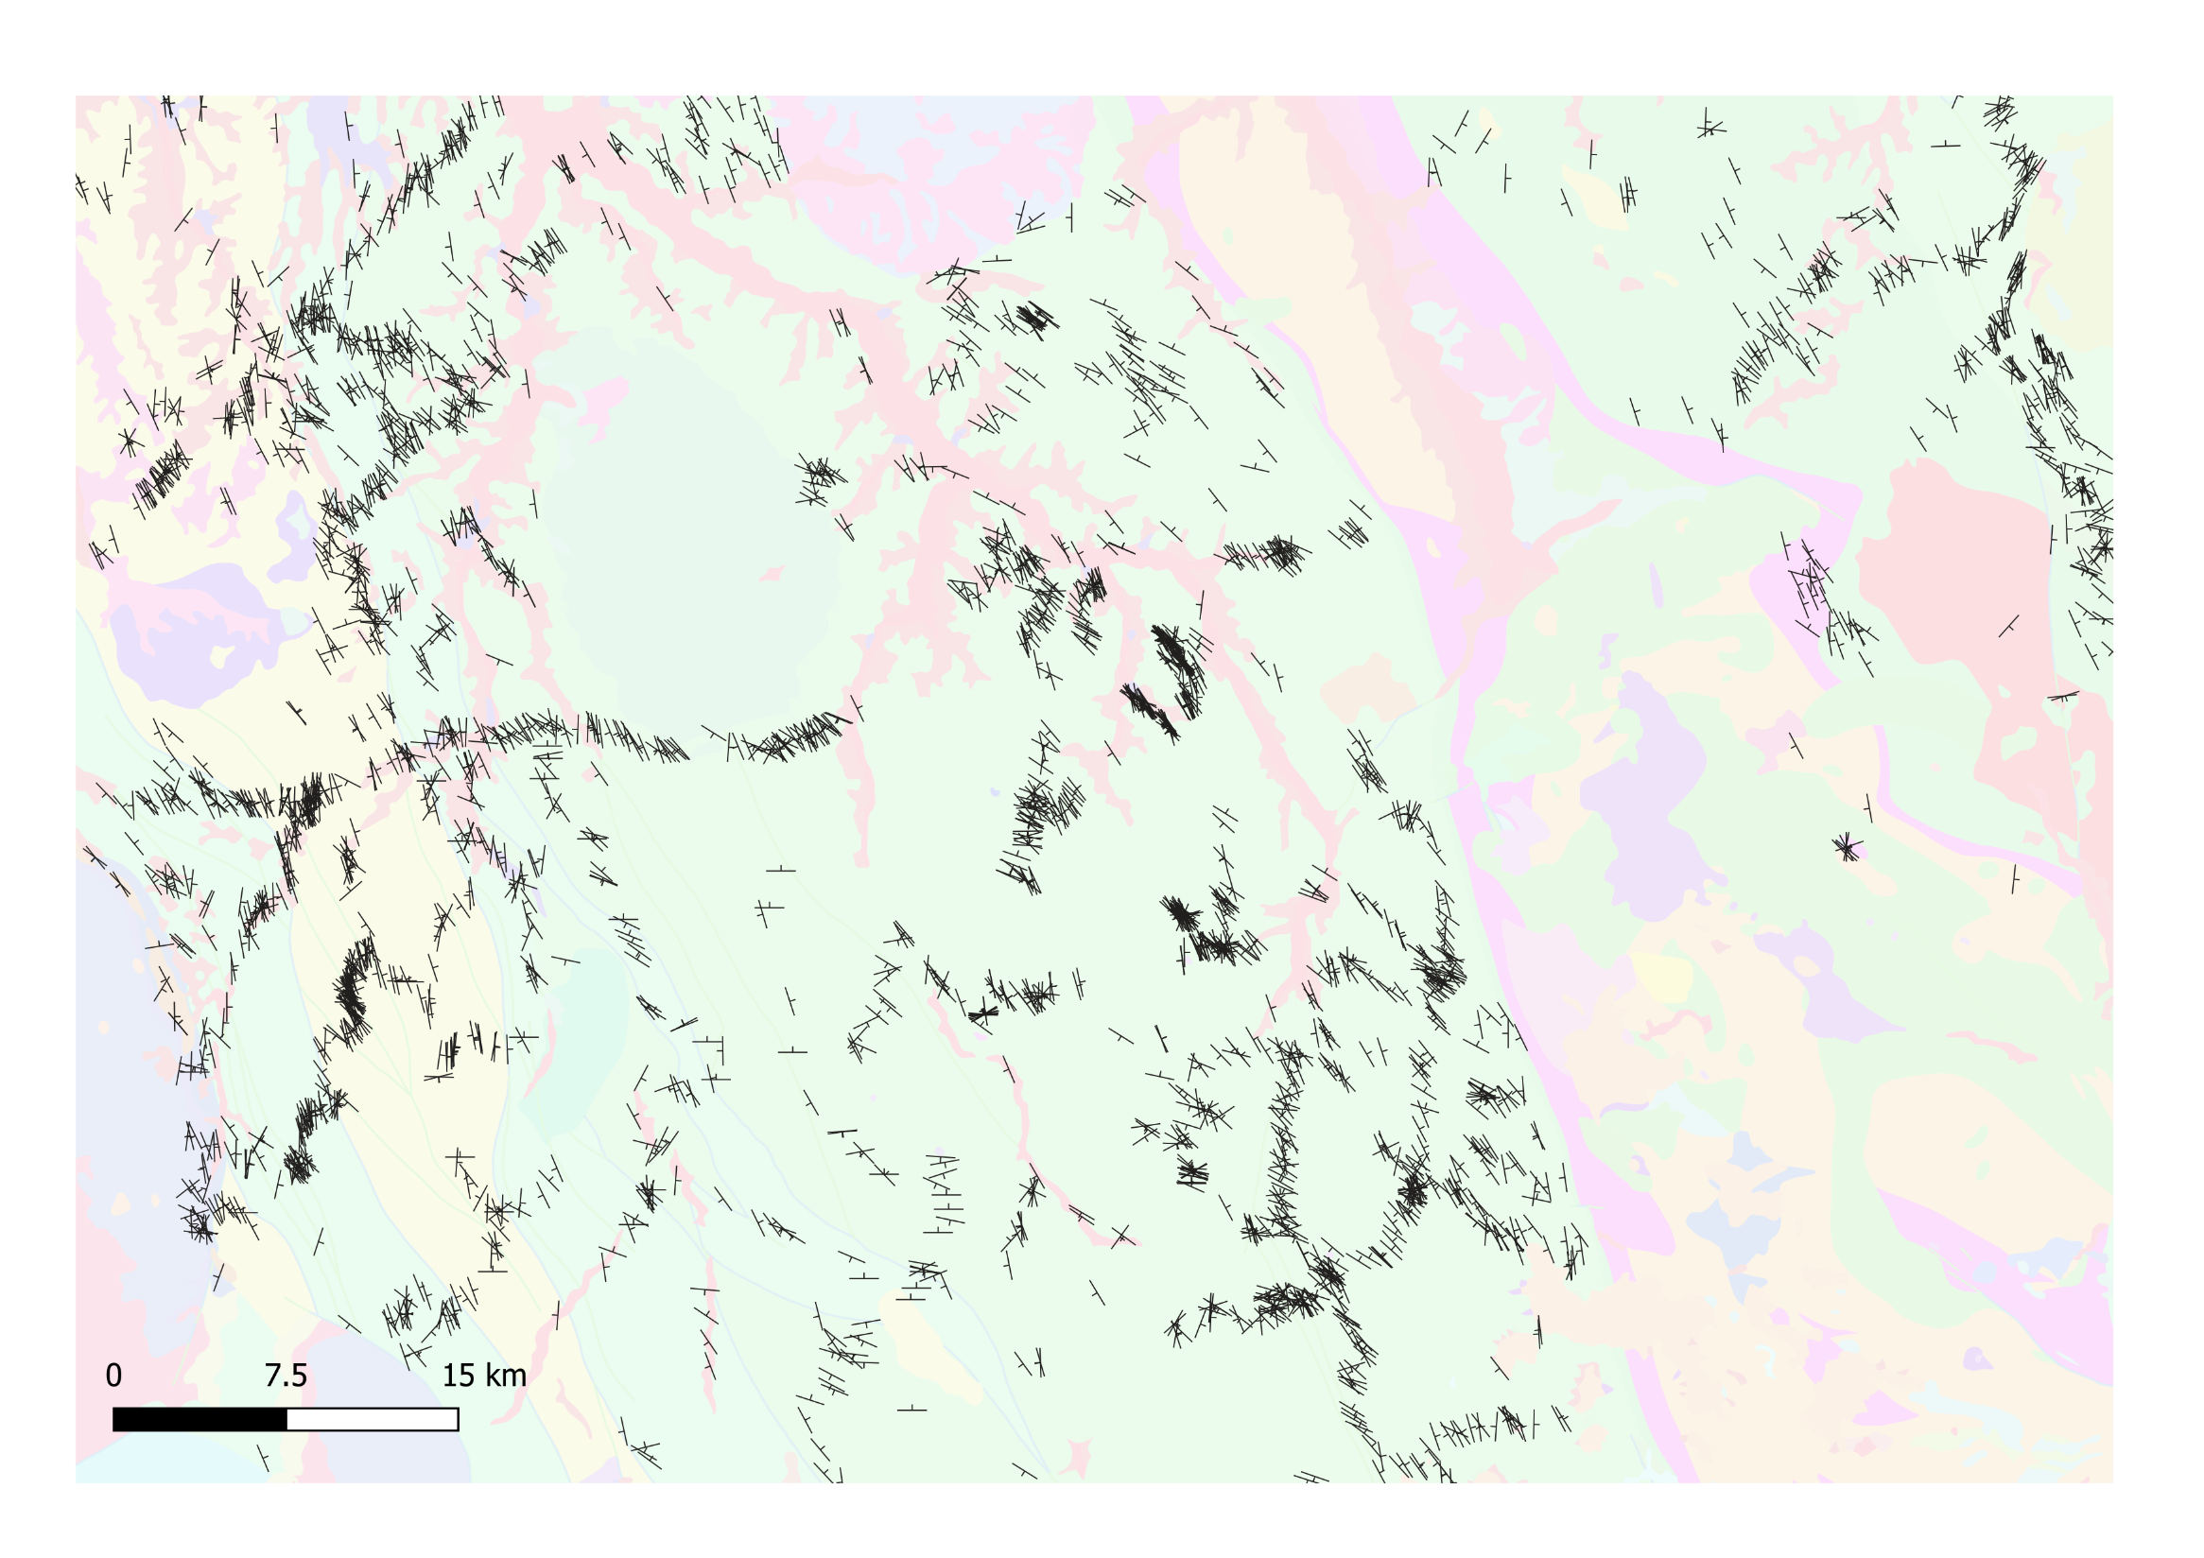

Upscaling, at present:
Keep X% of observations
Grid Approaches
Contact Aware Approaches
Ranee Joshi

Slide 25
2. Ranee Joshi: Up/down scaling and variable scale models
Method | Description
Decimation on basal contacts (existing map2loop function) | This algorithm simply removes every nth point from the input polylines.
Ramer–Douglas–Peucker algorithm | The Douglas–Peucker algorithm selects the vertices to delete based on minimizing local area changes from node deletion.
Visvalingam–Whyatt algorithm | This method preserves topological relationships to adjacent polygons, preserves proximity to other polygons and preserves shape patterns that are necessary in geological interpretations.
Modified Visvalignam-Wyatt | This newly-developed code lists the shared borders and critical shared points to be preserved prior to applying the Visvalignman-Whyatt simplification, to ensure that triple points and shared polygon contacts are preserved.
Method | Description
Subsampling based on decimation (existing map2loop function) | This subsampling was done using the built-in function in map2loop to delete every nth point from the sequence of spatially ordered samples.
Stochastic subsampling | This method involved randomly subsampling the initial input dataset with varying percentage of data degradation.
Grid cell averaging | Grid-cell averaging was done to estimate the data on a coarser regular grid. The estimates are computed by treating each orientation measurement within each cell as a 3D vector and taking the mean vector.
Spherical statistics – Kent Distribution | The Kent Distribution treats the dip and dip direction orientation data as 3D vectors and compares how close a set of orientation data points are to each other in terms of their angle, and stores a representative orientation.
Outlier Removal | In this new method, we take the results of the Kent Distribution to identify and remove outliers in the dataset.
Subsampling based on first-order measurements | A new subsampling technique that is based on the scale of the features. The structural bedding measurements are subsampled based on the orientation consistency and proximity of bedding orientation measurements to observed contacts.

Slide 26
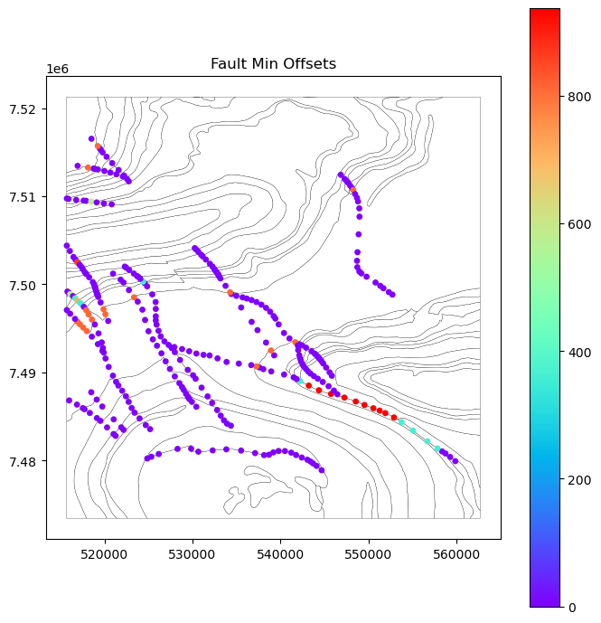
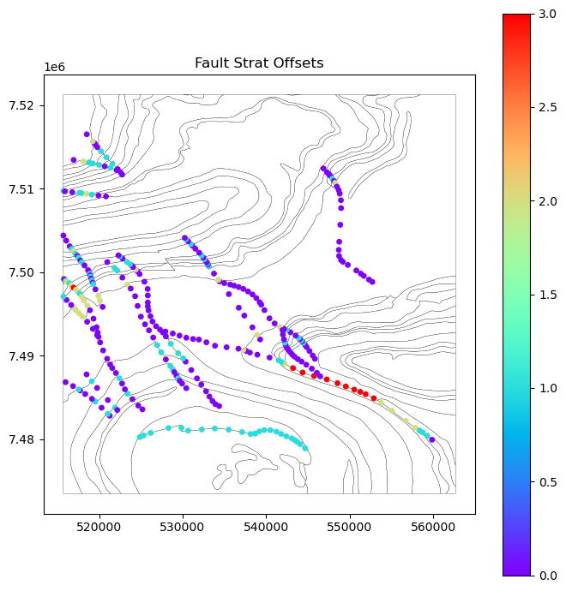
Fault Offsets at present

Slide 27
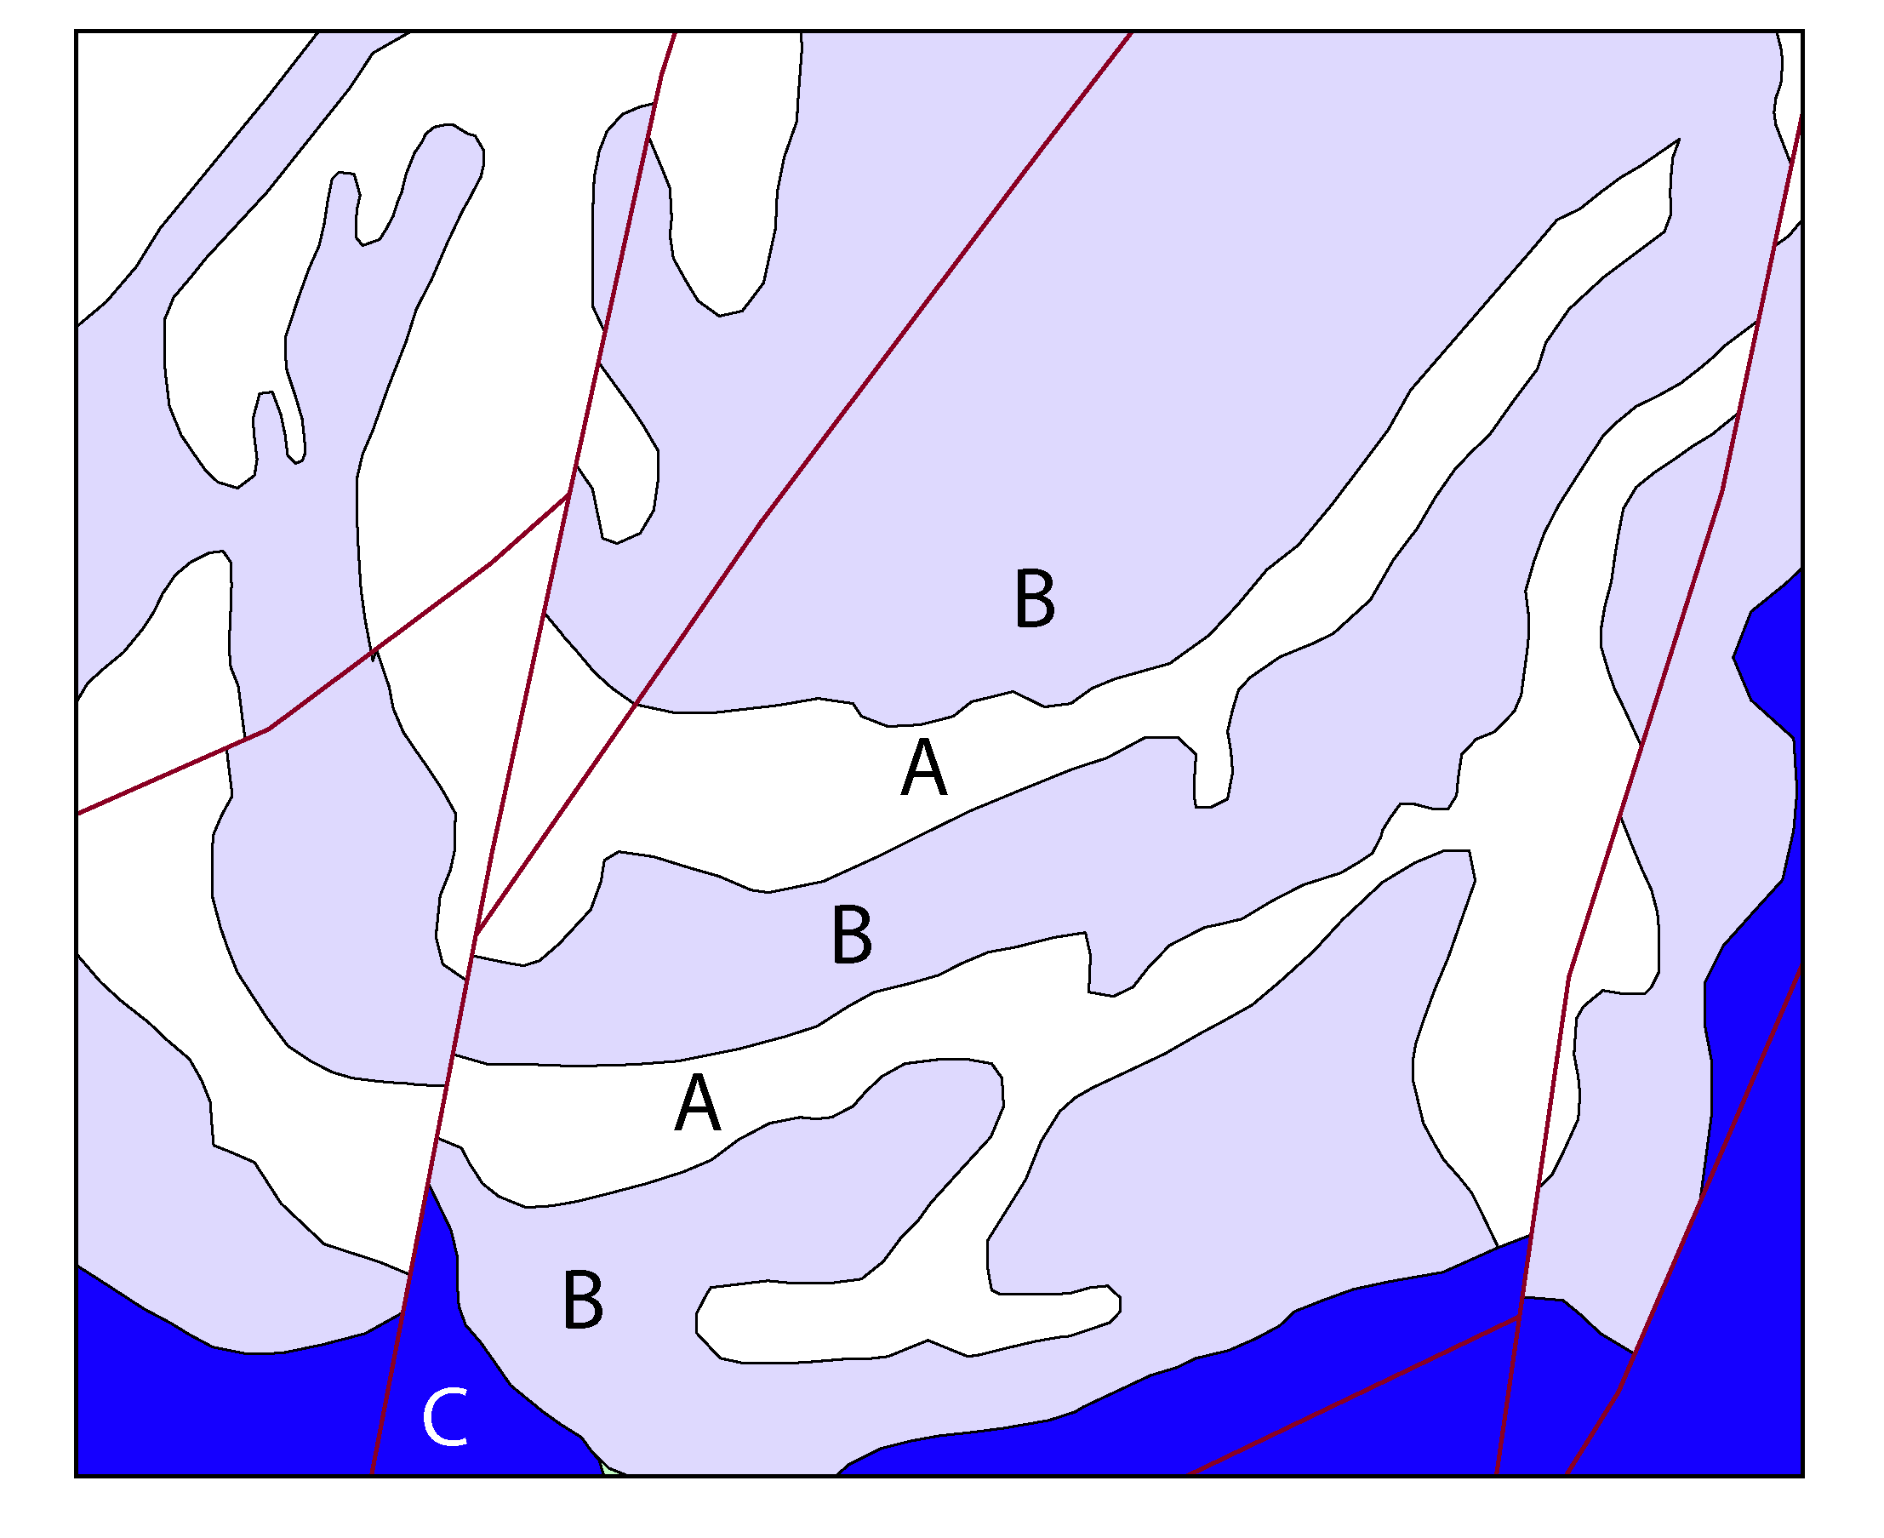
More map analysis to overcome, or at least highlight map ‘quirks’:
Fault topology
No offsets, possible but unlikely
Incoherent ages
Does the C-B-A-B-A-B sequence simply reflect lithology, or is it folded and or faulted stratigraphy?
Recoding formations, e.g. when a polygon is labelled as a Group

Slide 28
Stratigraphy and Fault Age relationships, at present:
One of many possible age sortings is chosen for both faults and stratigraphy
No use of Faults vs Folds vs Stratigraphy to further refine age relationships
f
Fold axial trace

Slide 29

Bedding
What we currently use in map2loop

Slide 30
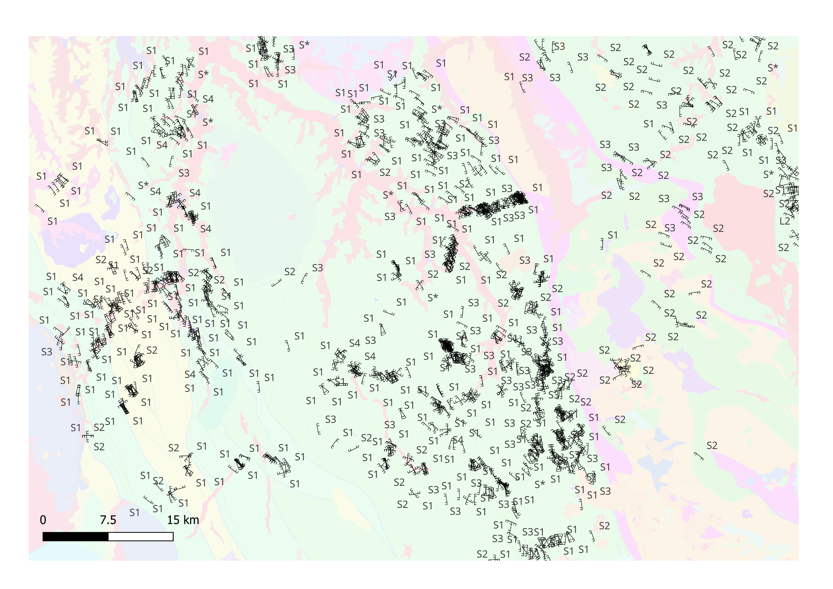
Cleavages

Slide 31
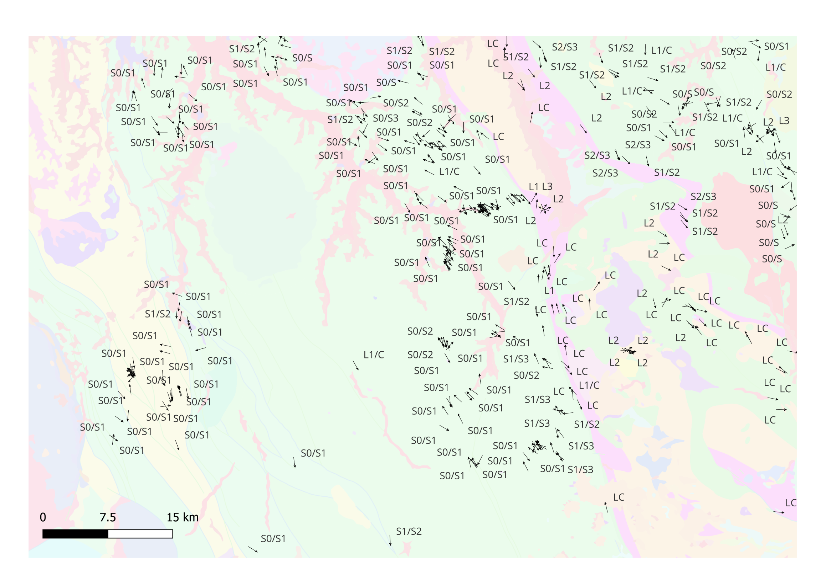
Intersection Lineations
Local vergence calculations will feed into LoopStructural’s age-aware calculations

Slide 32
map2loop automation :
Significantly reduces the time to first prototype models;
Allows reproducible modelling from raw data, whereas current Uncertainty Quantification workflows start from model-ready inputs;
Clearly separates the primary observations, interpretations, derived data and conceptual priors during the data reduction steps; and
Provides a homogenous pathway to Sensitivity Analysis, Uncertainty Quantification, Multiscale Modelling and Value of Information studies.

Slide 33


Proof of concept, use at your own risk!

